Slide 1
Covid19
By: Logan Armstrong and Josh Schulz

Slide 2
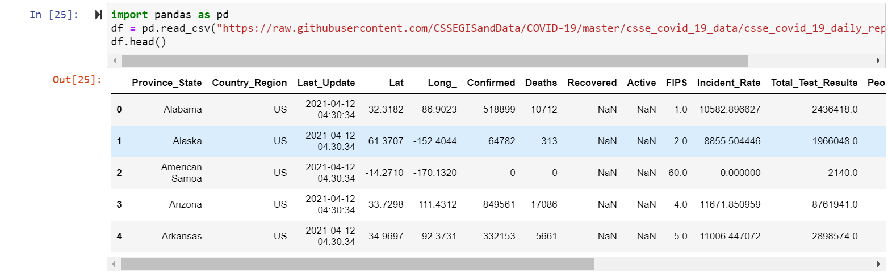
Data
https://raw.githubusercontent.com/CSSEGISandData/COVID-19/master/csse_covid_19_data/csse_covid_19_daily_reports_us/04-11-2021.csv

Slide 3
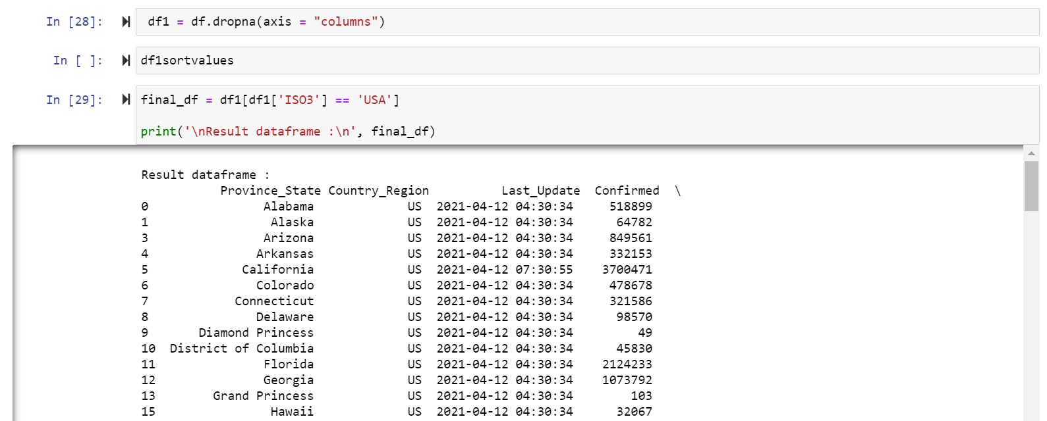
Cleaning up the data

Slide 4
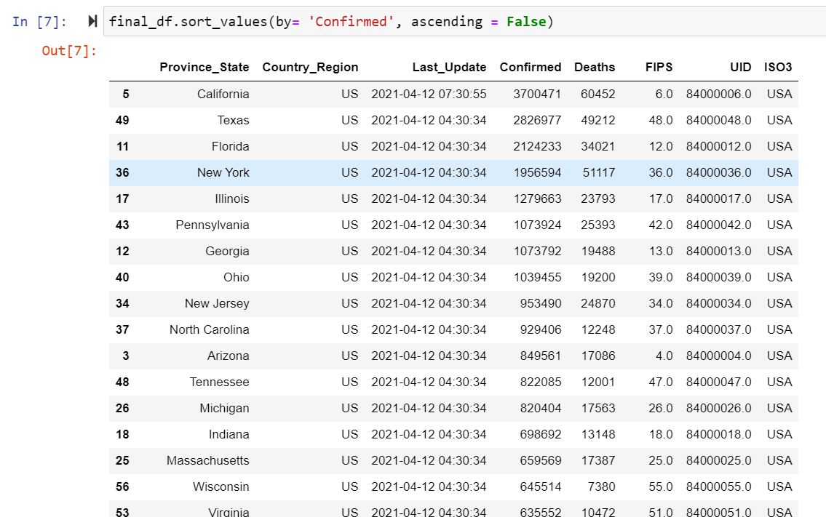
Analyzing the Data

Slide 5
Demo of the data

Slide 6
Import the data to SQL

Slide 7
Demo of the SQL tables

Slide 8
Conclusion

Slide 9
Questions???

